Slide 1
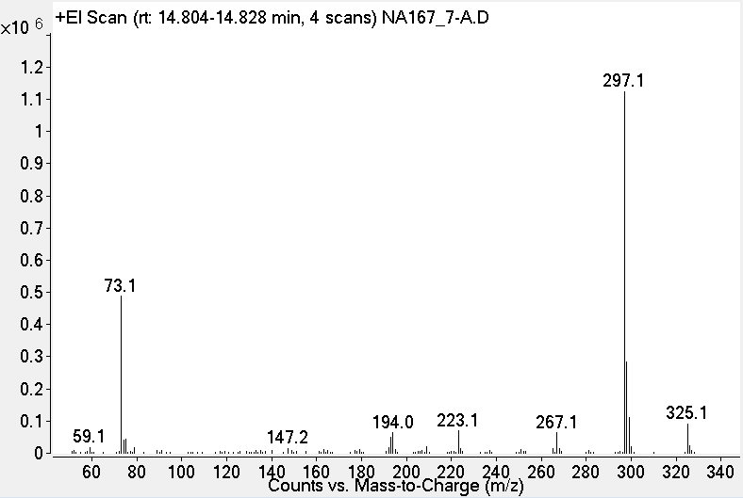
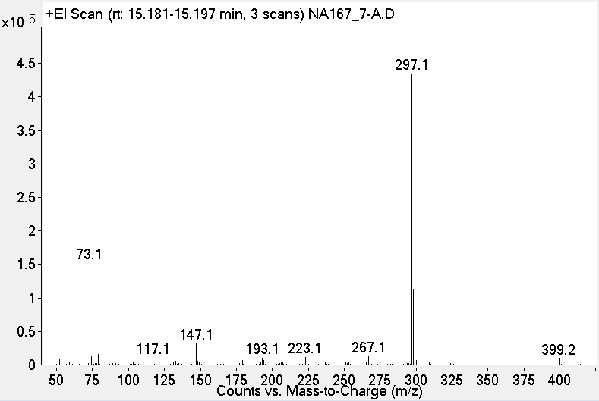
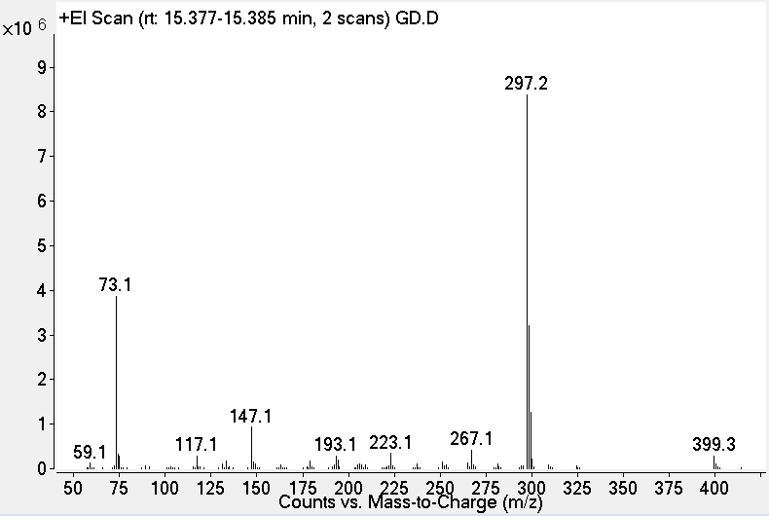
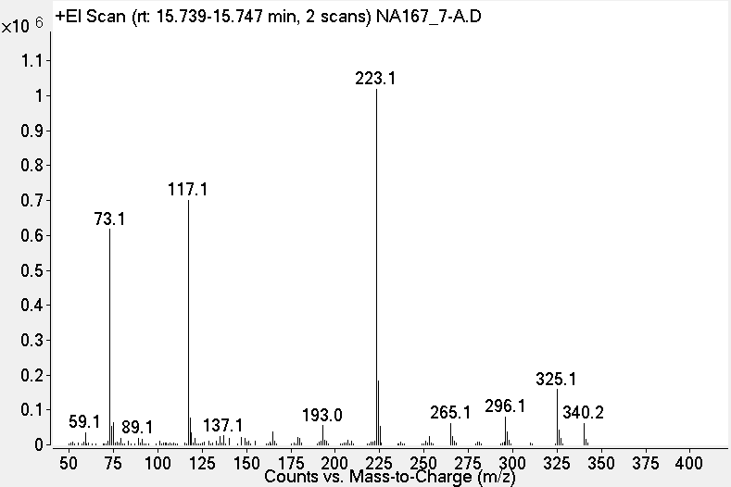
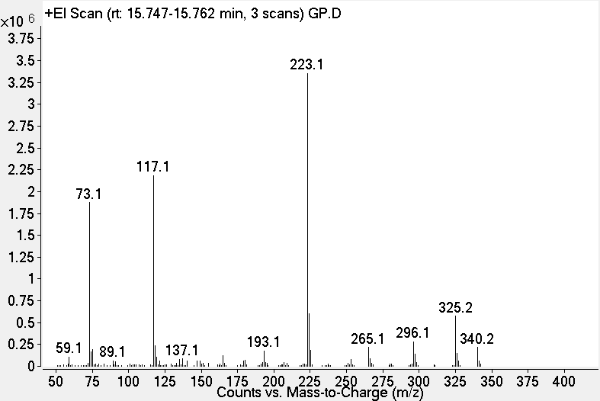
x10⁷
GC-MS chromatogram of culture supernatant 75.5 hr
2
Counts
1
0
Counts vs. Acquisition Time (min)
TMS-GP-2 (RT 14.81 min)
TMS-erythro-GD (RT 15.19 min)
TMS-threo-GD (RT 15.36 min)
TMS-GP-1 (RT 15.74 min)
TMS-threo-GD authentic standard
TMS-GP-1 authentic standard

